Slide 1



SMART INDIA HACKATHON 2025
TITLE PAGE
Problem Statement ID – SIH25074
Problem Statement Title – AI-Powered Personal Farming Assistant for Kerala Farmers
Theme – Agriculture, FoodTech & Rural Development
PS Category – Software
Team ID – 98828
Team Name (Registered on portal) : Team Bashers

Slide 2
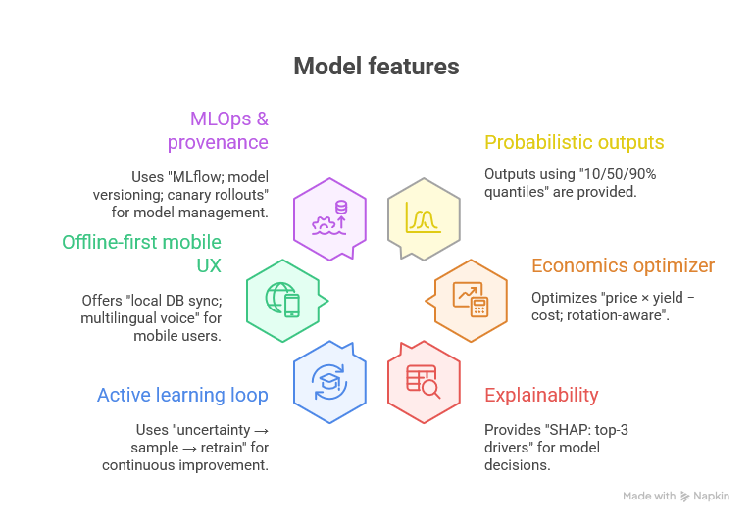
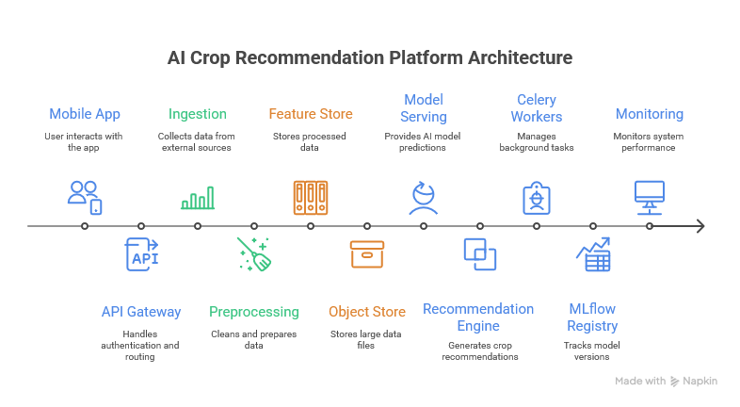
IDEA TITLE
Proposed Solution (Describe your Idea/Solution/Prototype)
How it addresses the problem
Innovation and uniqueness of the solution
Team Bashers
The AI-Based Crop Recommendation System is a platform which uses machine-learning to suggest the most appropriate crop for a farmer to plant based on a comprehensive set of real-time and historical data.
What and Why needed?
What: A dynamic, data-driven decision support system. It takes input on soil parameters (pH, nitrogen, phosphorus, potassium, moisture), climate data (temperature, humidity, rainfall), and geographical location.
Why needed: To maximize profitability and sustainability. Our uniqueness lies in combining explainable AI, economics optimization, offline-first design, and robust MLOps around a hybrid XGBoost+Fuzzy Logic decision engine.
Innovation and uniqueness of the solution
Detailed explanation of the proposed solution
How it addresses the problem
What and Why needed?
How will it help?

Slide 3
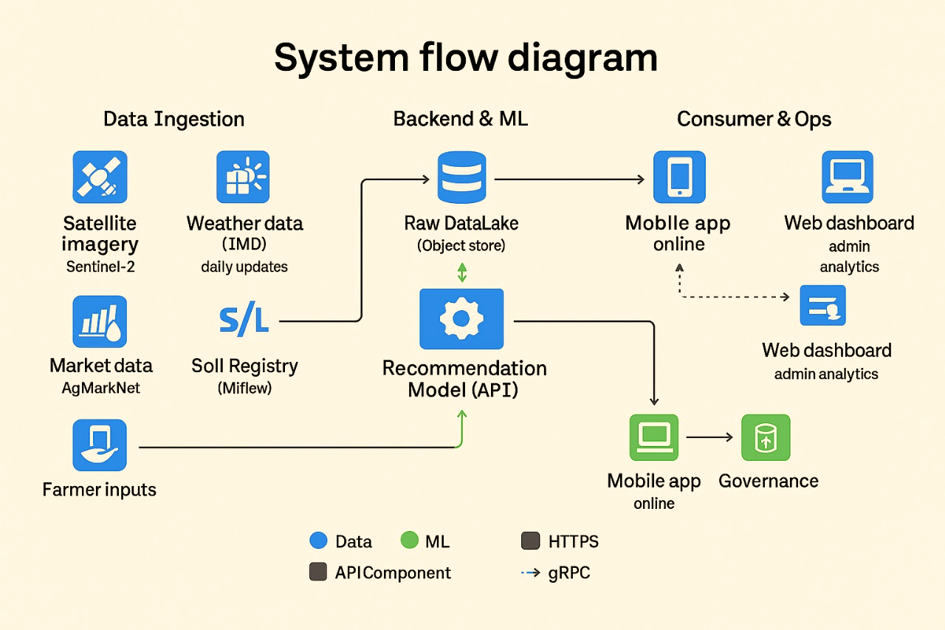



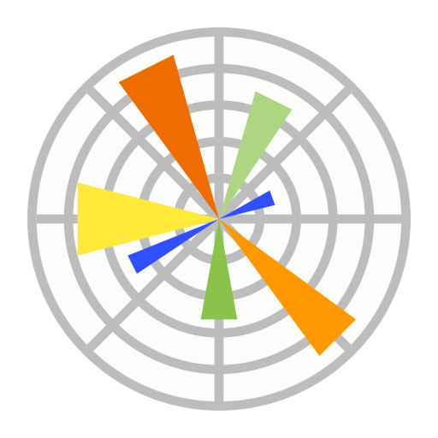












TECHNICAL APPROACH
Technologies to be used (e.g. programming languages, frameworks, hardware)
Methodology and process for implementation (Flow Charts/Images/ working prototype)
Team Bashers
Technology Stack
Frontend : React Js, React Native.
Backend : Node Js, REST API, Flask or FastAPI, PostgreSQL, BeautifulSoup, Selenium, matplotlib.
AI and ML : Scikit-Learn or TensorFlow, pandas.
API Services : Bhashini, ISRO BhuvanAPI, SoilGrids, OpenweatherAPI.
Deployment : AWS, Docker, Github, Kubernetes.
Additional : Redis, Postman, Agmarknet.
PROTOTYPE LINK

Slide 4







FEASIBILITY AND VIABILITY
Analysis of the feasibility of the idea
Potential challenges and risks
Strategies for overcoming these challenges
Team Bashers
FEASIBILITY
Technical : Uses AI/ML, cloud, mobile app, and existing weather/market APIs.
Architecture : Modular design for phased development.
Market : High demand from farmers for yield optimization and cost reduction.
Economic : Low initial cost, utilizing open-source frameworks.
USE CASES
New Farmers: Quick start for optimal crop selection.
Experienced Farmers: Optimize practices, implement rotations, and use market data.
Government: Data-driven policy making and resource allocation.
Agri-Businesses: Identify ideal regions for sourcing and contract farming.
Researchers: Access to anonymized, aggregated datasets.
VIABILITY
Revenue : Multi-stream approach (Govt. partnerships, data analytics).
User Base : Targets millions of small and marginal Indian farmers (mass adoption).
Scalability : Easily expandable from local to state/national levels.
Sustainability : Promotes long-term soil health and farmer income growth.
BUSINESS POTENTIAL
Partnerships: Align with national schemes (PM Kisan, e-NAM) for deployment.
Data Services: Sell insights to research, seed, and fertilizer companies (anonymized).
Premium Model: Offer subscriptions for advanced agronomy, alerts, and market links.
Local Services: Connect farmers to local experts, labs, and equipment rentals.
CHALLENGES
User Adoption : Farmers may struggle with complex UI and digital literacy.
Infrastructure : Limited IoT infrastructure in Indian villages.
Market Competition : Similar apps already exist.
Financial/Sustainment : Continuous maintenance cost (API servers, training).
SUPPORTING FACTS FOR FEASIBILITY AND VIABILITY
In Palakkad (Chittur taluk), about 1,000 farmers have adopted precision agriculture. For some, switching from regular paddy to precision‐vegetable farming gave ~ ₹75,000 to ₹1,50,000 per acre/year.
Studies show mobile phones/apps are improving how rural women farmers in places like Palakkad access market price info, weather, pest control etc. → better decision making, less loss.
Such tech is helping reduce water usage by 50% and providing crop-health alerts via satellite & remote sensing.
SOLUTIONS
Provide voice assistant, large buttons, simple step-based flow, and a clean layout.
Add new datasets/APIs over time, ensuring adaptability to crops & climate trends.
Use features like crop rotation, profit analysis, and voice guidance in local language.
Partner with government schemes like eNAM and startups for funding and deployment.

Slide 5
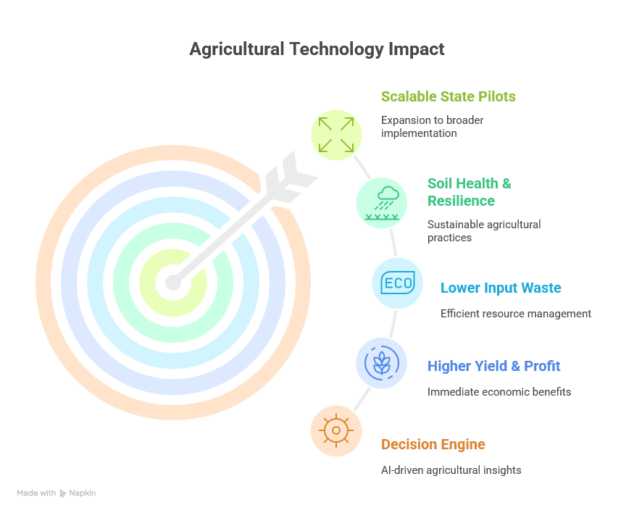
IMPACT AND BENEFITS
Potential impact on the target audience
Benefits of the solution (social, economic, environmental, etc.)
Team Bashers
🌱 Impacts
Quick Adoption: Farmers with no prior experience can start in a short time.
Policy Support: Government agencies get access to official, reliable, data-driven insights.
Economic Growth: Boosts planning, employment, food production, and state GDP.
Trust in Digital Tools: Builds confidence among farmers for using tech-driven solutions.
Sustainable Development: Reduces fertilizer use, promotes organic farming.
🌾 Benefits
Farmer Inclusion: Especially supports small & marginal farmers (majority of India’s agri sector).
Government Alignment: Can integrate with schemes like PM-Kisan, Digital Agriculture Mission, e-NAM.
Digital India Push: Directly supports Digital India & Atmanirbhar Bharat goals.
Financial Savings: Farmers save money by matching exact needs & planning better.
Ease of Use: Simple UI & Malayalam language options → hassle-free adoption.
Better Yields: Increased yield, higher profits, reduced crop failures.
Food Security: Conserves water and strengthens food security.

Slide 6
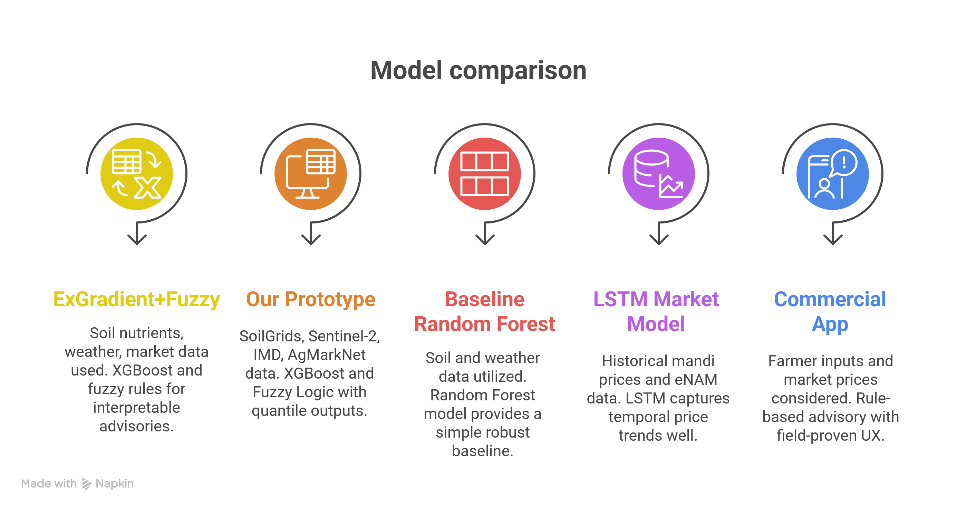
RESEARCH AND REFERENCES
Team Bashers
RESEARCH FACTS
6th Edition of Handbook Of Agriculture : Facts And Figures by ICAR 🔗
Smart Farming: Challenges and Future Ideas 🔗
XGBoost and Random Forest Algorithms: An in Depth Analysis 🔗
India: Issues and Priorities for Agriculture 🔗
Indian Council of Agricultural Research 🔗
Crop recommendation system with supervised machine learning 🔗
Soil-Specific Crop Recommendation with AI: The XGB-FuzzyIncNet Approach 🔗
FEASIBILITY FACTS
Empowering Rural Women Farmers Through Mobile Technology in Kerala 🔗
The Rise of Agritech in Kerala 🔗
High profit lures farmers to high-tech precision agriculture 🔗

